Slide 1

DS 597(APPLIED RESEARCH EXPERIENCE)
JYOTHSNA

Slide 2
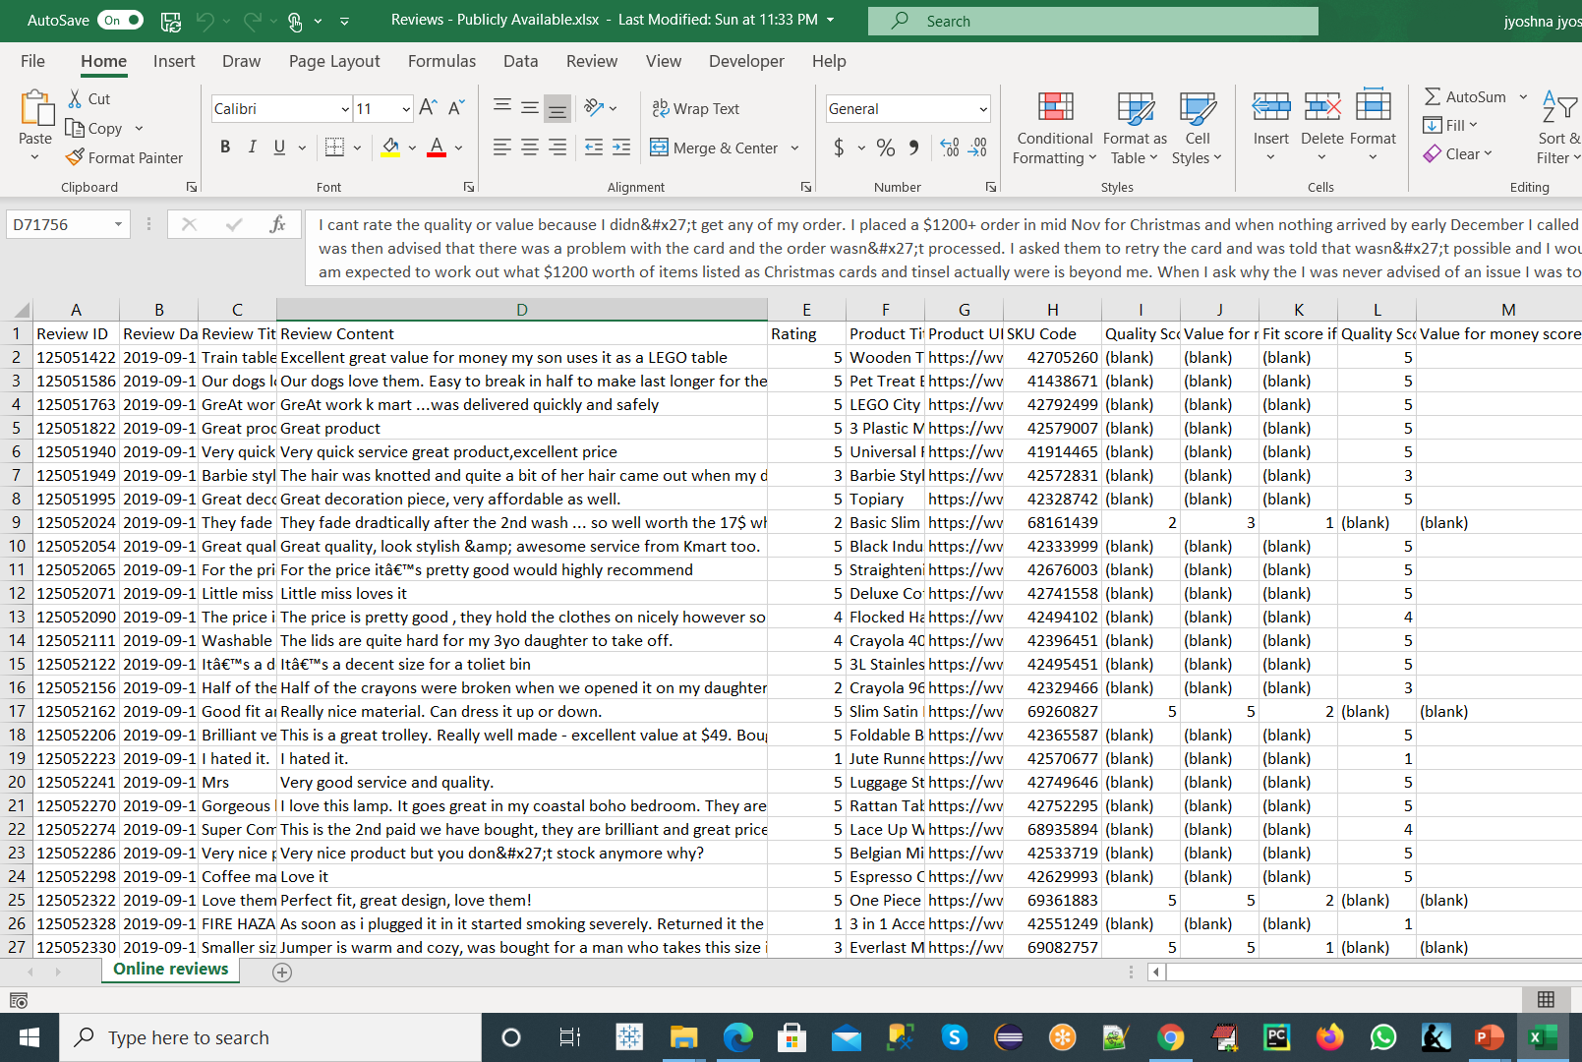
DATA SET

Slide 3

PROBLEM STATEMENT
Analyze product reviews at scale through an algorithm that can identify key themes and enable buyers, suppliers, and quality inspectors take actionable decisions around product quality risk mitigation and improve customer satisfaction

Slide 4

APPROACH
Using the features in place to build a classifier that can determine review’s sentiment

Slide 5
PROCESS
Data Cleaning
Unsheathing Key Factors
Visualization
Data
Pre-Processing
Visualization with
Jupyter
Aspect
Extraction
Polarity
And
Sentiment Scoring
Aspect
Polarity
Data
Profiling
Exploratory Data Analysis
Sentiment Analysis
Frequency Calculation

Slide 6
Data Cleaning Process
The process of grouping together the different inflected forms of a word so they can be analyzed as a single item.
To avoid having multiple copies of the same words.
Removal of commonly occurring words from the text data
Special Characters
Stemming
Lowercasing
Stopwords
Lemmatization
Removing all instances of special characters will help reduce the size of the training data
The process of reducing each word to its root or base

Slide 7
Nlp Tools and Libraries used for this Approach
Pandas
Numpy
Matplotlib
Seaborn
NLTK
CountVectorizer
SkLearn
Textblob
Tweepy
WordCloud
Regex
Vader Lexicon
Spacy
Displacy

Slide 8
Methodology or steps involved
Importing the dataset
Importing necessary libraries
Handling missing and cleaning the data
Removing Stopwords and Punctuations
Message Cleaning
Tokenizing
Finding Polarity score of Ratings
Splitting data into training and testing
Setting Target Variable
Evaluating Sentiment Analysis
Testing the Model with best Classifier
Evaluating the Model best suited

Slide 9
ML and NLP Techniques/Algorithms Used
Support Vector Machine
Bayessian Networks
Decision Tree
Random Forest Classifier
Logistic Regression
Tokenization
Speech Tagging
Named Entity Recognition
Pos Tagging

Slide 10

Explonatory Data Analysis,Machine Learning and NaturalLanguageProcessing
)

Slide 11
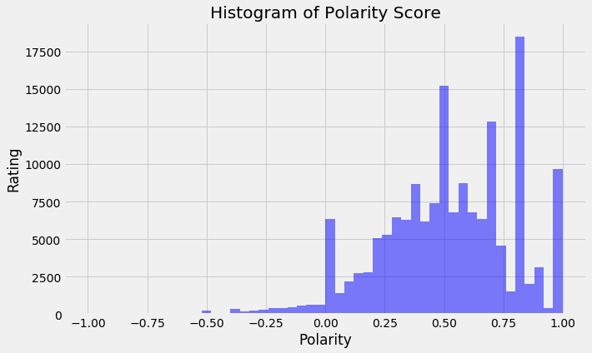
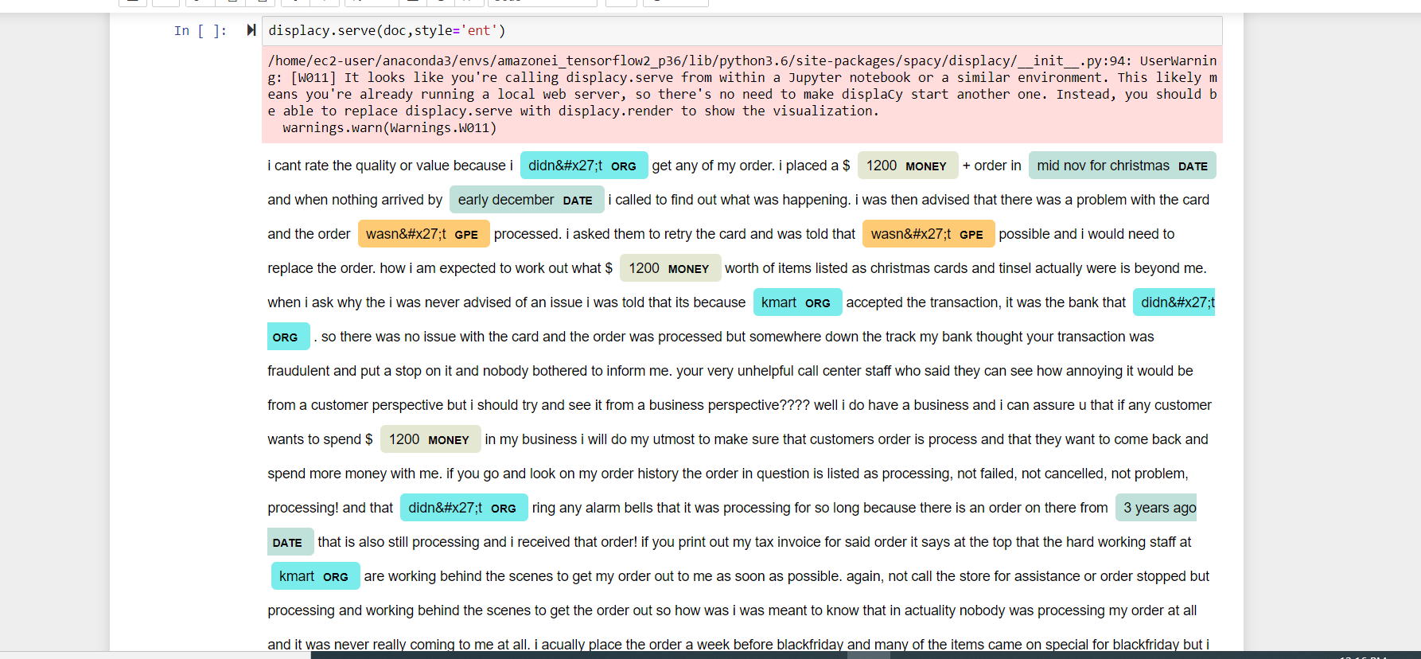
Some of Visualizations Graphs

Slide 12
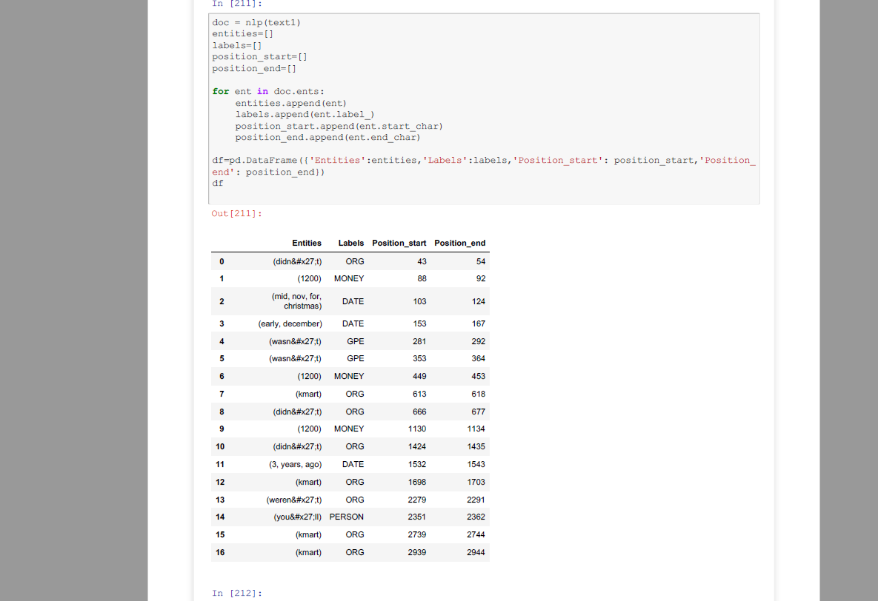
NAMED ENTITY RECOGNITION

Slide 13
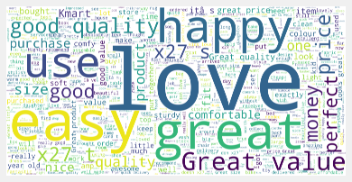
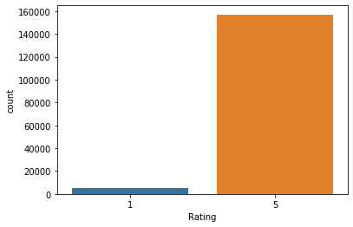
WORDCLOUD AND COUNTPLOT

Slide 14
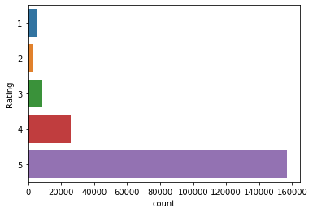
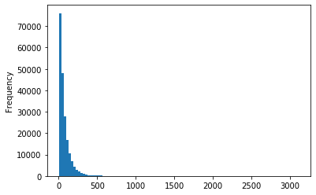
BAR GRAPH AND HISTOGRAM

Slide 15
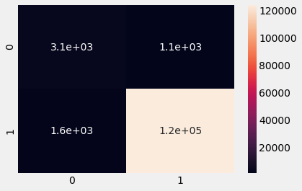
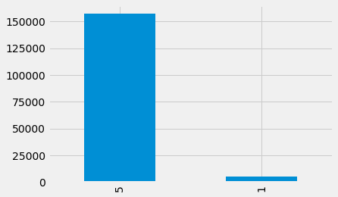
COUNT PLOT AND HEAT MAP

Slide 16
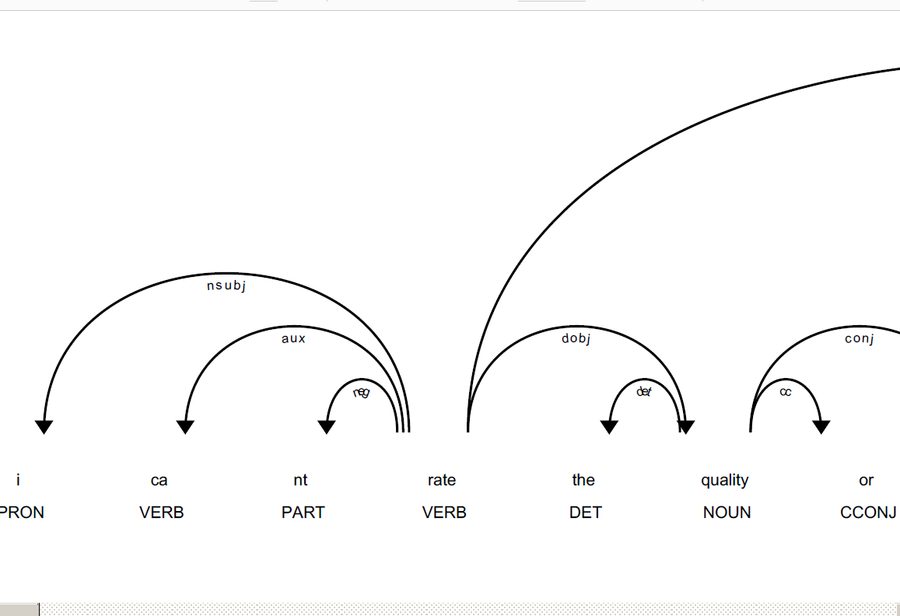
DISPLACY

Slide 17
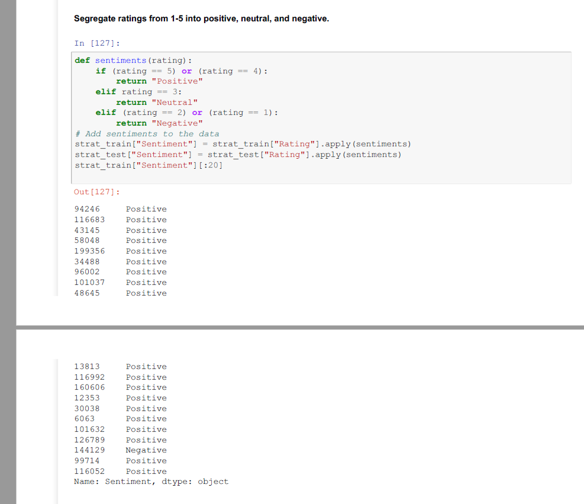
SENTIMENT ANALYSIS FOR RATING

Slide 18
Predictions/Interpretations
Decision Tree Classifier – Accuracy Score 95.01%
Random Forest Classifier – Accuracy Score 95.32%
Support Vector Machine – Accuracy Score 96.15%
Multinomial Naïve Bayes – Accuracy Score 91.08
Logistic Regression Classifier –Accuracy Score 93.28%

Slide 19
Results/Metrics
All the models have performed well greater than 90%
Support Vector Machine Classifier since it has the highest accuracy level at 96.15%.

Slide 20
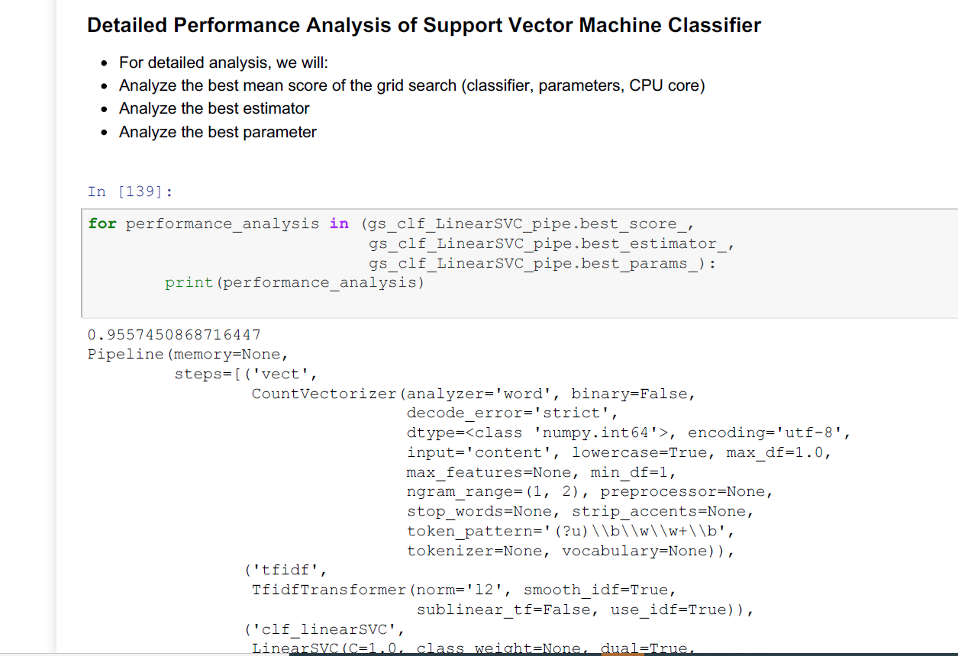
Detailed Analysis of SVM

Slide 21
Detailed Analysis of SVM
Also, with longer documents, we typically see higher average count values on words that carry very little meaning, this will overshadow shorter documents that have lower average counts with same frequencies, as a result, we will use TfidfTransformer to reduce this redundancy
Term Frequencies (Tf) divides number of occurrences for each word by total number of words
Term Frequencies times Inverse Document Frequency (Tfidf) downscales the weights of each word (assigns less value to unimportant stop words ie. "the", "are", etc)
Here we see that the best mean score of the grid search is 95.57% which is very close to our accuracy level of 96.15%
Our best parameters are true for use_idf in tfidf, and ngram_range between 1,2

Slide 22
Summary of Classification Report
Precision: determines how many objects selected were correct
Recall: tells you how many of the objects that should have been selected were actually selected
F1 score measures the weights of recall and precision (1 means precision and recall are equally important, 0 otherwise)
Support is the number of occurrences of each class
The results in this analysis confirms our previous data exploration analysis, where the data are very skewed to the positive reviews as shown by the lower support counts in the classification report. Also, both neutral and negative reviews has large standard deviation with small frequencies, which we would not consider significant as shown by the lower precision, recall and F1 scores in the classification report.
However, despite that Neutral and Negative results are not very strong predictors in this data set, it still shows a 94.08% accuracy level in predicting the sentiment analysis, which we tested and worked very well when inputting arbitrary text (new_text).Therefore, we are comfortable here with the skewed data set. Also, as we continue to input new dataset in the future that is morebalanced, this model will then re-adjust to a more balanced classifier which will increase the accuracy level.
Finally, the overall result here explains that the products in this dataset are generally positively rated.

Slide 23
Analysis of Classification Report
From the analysis above in the classification report, we can see that products with lower reviews are not significant enough to predict these lower rated products are inferior. On the other hand, products that are highly rated are considered superior products, which also performs well and should continue to sell at a high level.
As a result, we need to input more data in order to consider the significance of lower rated product, in order to determine which products should be dropped from KMart's product roster.
Despite the skewed dataset, we were still able to build a robust Sentiment Analysis machine learning system to determine if the reviews are positive or negative. This is possible as the machine learning system was able to learn from all the positive, neutral and negative reviews, and fine tune the algorithm in order to avoid bias sentiments.
In conclusion, although we need more data to balance out the lower rated products to consider their significance, however we were still able to successfully associate positive, neutral and negative sentiments for each product in Kmart's Catalog.

Slide 24
CONCLUSION
Also, this is a result of positively skewed dataset, which is consistent with both our data exploration and sentiment analysis. Therefore, we conclude that the products in this dataset are generally positively rated, and should be kept from Kmart’s product roster.

Slide 25
THANK YOU

